Slide 1

Navigating the Digital Waters: Phishing Awareness
In our increasingly interconnected world, digital security is paramount. This presentation will empower you with the essential knowledge and practical strategies to recognize, avoid, and defend against phishing attacks, thereby protecting our shared digital environment.

Slide 2
Agenda: Your Phishing Defense Playbook
01
02
03
Understanding Phishing
Spotting the Signs
The Art of Social Engineering
What it is and why it matters to you.
How to recognize suspicious emails and websites.
Unmasking the psychological tricks attackers use.
04
05
Your Best Defense
Real-World Scenarios
Actionable tips and best practices for staying safe.
Applying your knowledge through practical examples.

Slide 3
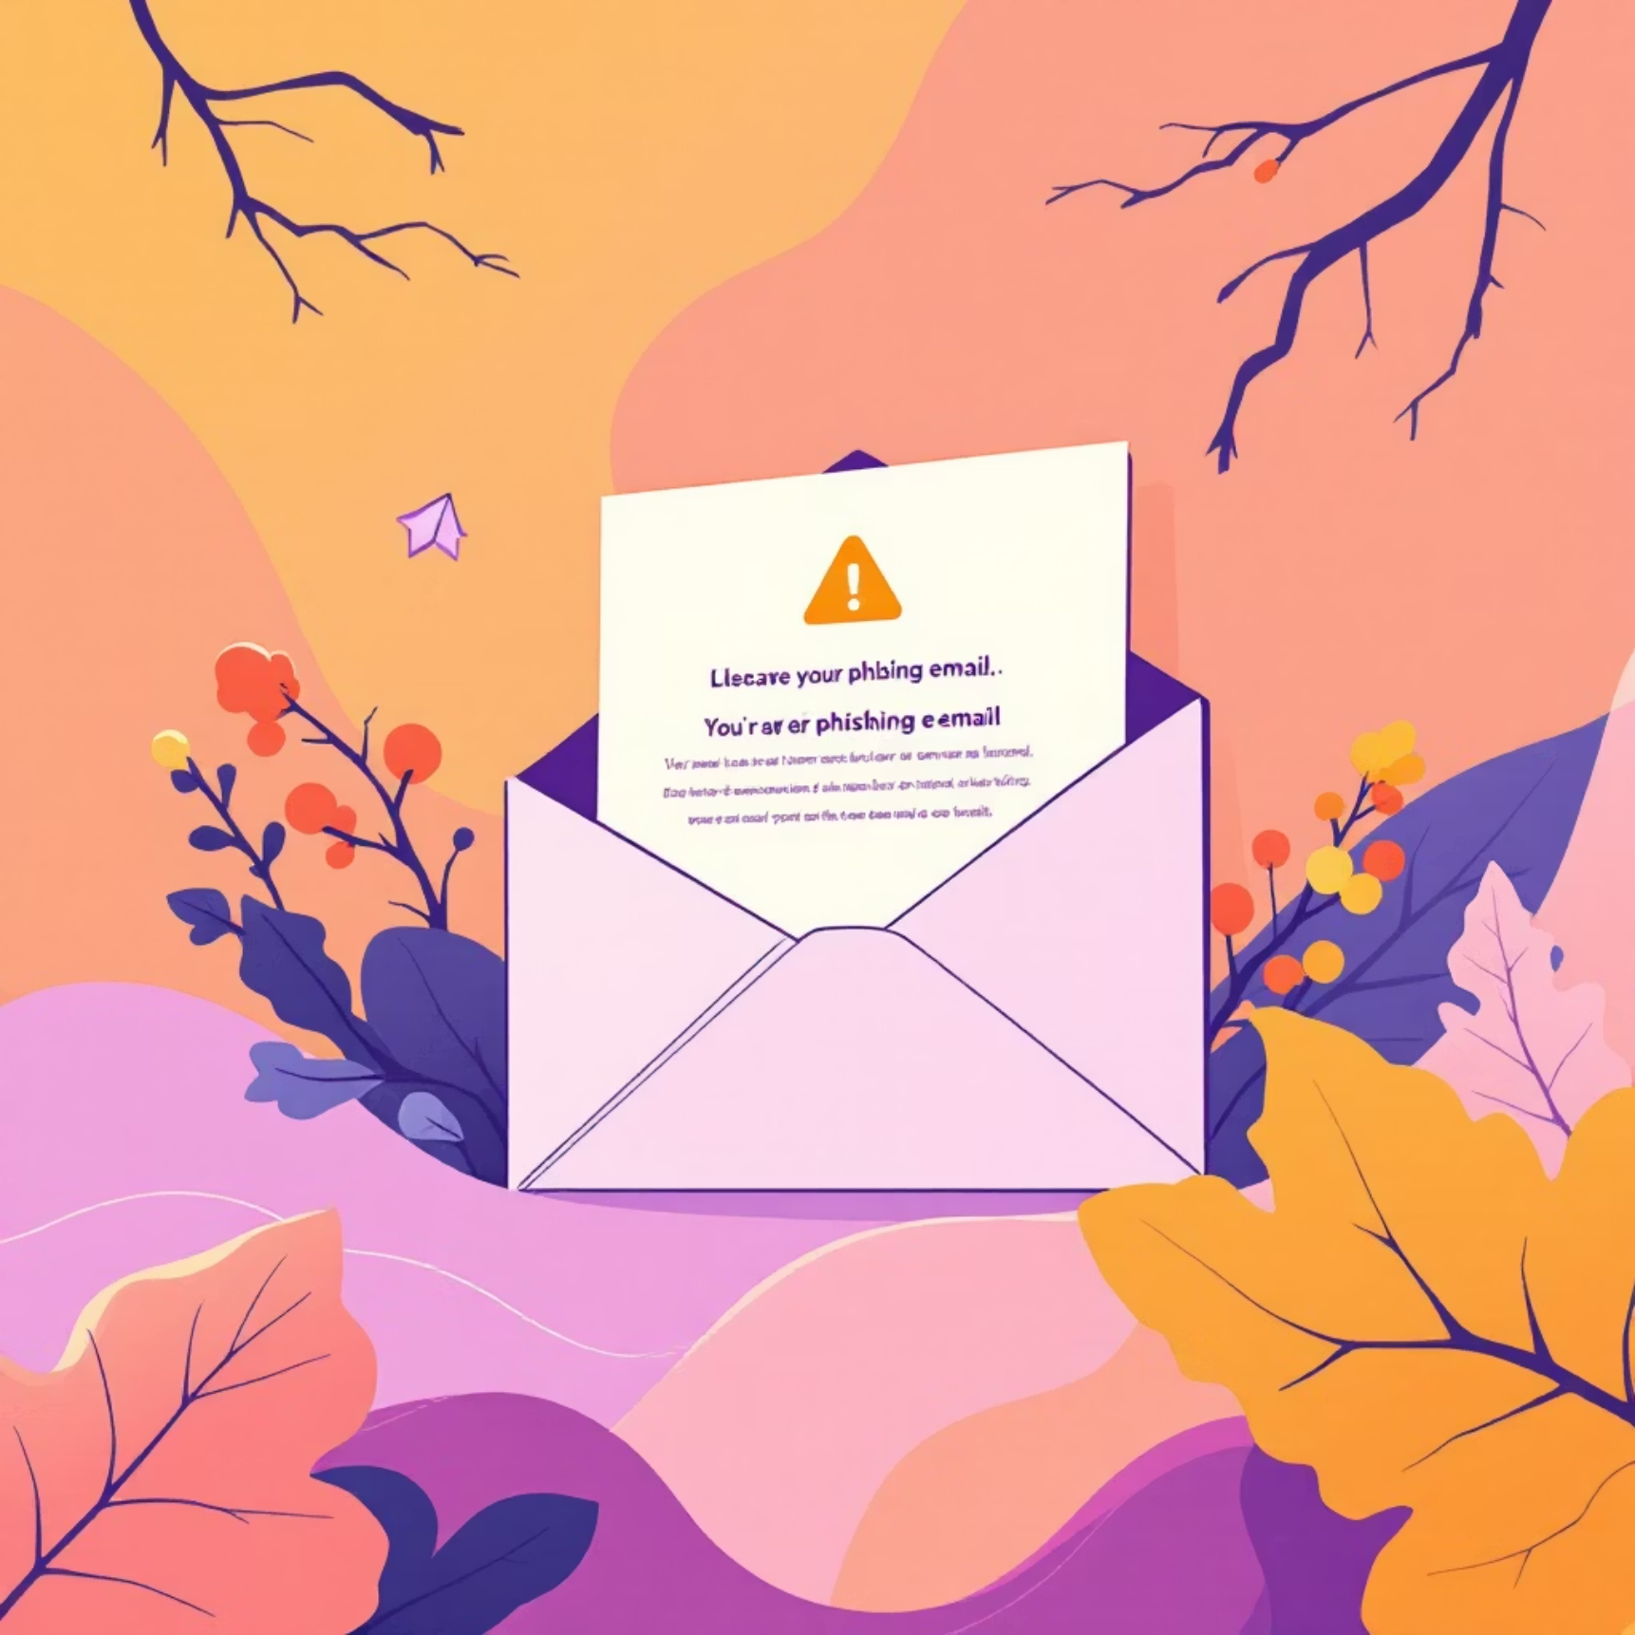
What is Phishing? The Bait and Switch
Phishing is a deceptive cyberattack where malicious actors attempt to trick individuals into revealing sensitive information, such as usernames, passwords, and credit card details, or to download malware. They achieve this by masquerading as a trustworthy entity in electronic communication.
Think of it as a digital fishing expedition. Attackers cast a wide net, hoping someone will bite. They often impersonate familiar organizations like banks, social media platforms, or even internal IT departments.
The goal is always the same: to gain unauthorized access to your accounts or data, leading to potential financial loss, identity theft, or system compromise.

Slide 4
Recognizing Phishing Emails: Look for the Red Flags
Urgent or Threatening Language
Generic Greetings
Messages demanding immediate action, threatening account closure, or promising unrealistic rewards.
Lack of personalization, addressing you as "Dear Customer" instead of your name.
Suspicious Links or Attachments
Spelling and Grammar Errors
Hover over links to check the URL (don't click!). Be wary of unexpected attachments.
Professional organizations rarely send emails with obvious mistakes.

Slide 5
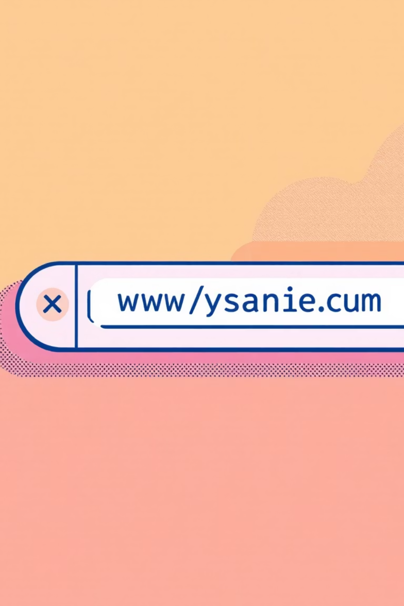
Identifying Fake Websites: Don't Get Hooked
Phishing attempts often direct you to convincing, but fake, websites designed to steal your credentials.
Check the URL Carefully
Inspect Website Design
Look for subtle misspellings (e.g., "Amaz0n.com" instead of "Amazon.com") or extra words. A secure site starts with "https://" and usually has a padlock icon.
While often sophisticated, fake sites might have low-resolution logos, inconsistent branding, or missing content sections.

Slide 6




Social Engineering: Playing on Your Emotions
Attackers often leverage social engineering tactics, manipulating human psychology to bypass security measures. They exploit trust, fear, urgency, or curiosity.
Impersonation
Urgency/Fear
Pretending to be someone trustworthy, like a colleague, IT support, or a senior executive.
Creating a sense of panic, like "your account will be locked," to force hasty decisions.
Lure of Rewards
Curiosity
Offering tempting but false promises, such as lottery winnings or exclusive deals.
Enticing you to click on links or open attachments to see something intriguing.

Slide 7
Your Best Defense: Proactive Measures
Empower yourself with these essential best practices to minimize your risk:
1
Verify Sender Identity
2
Use Strong, Unique Passwords
Always double-check the sender's email address, not just the display name. If unsure, contact the sender via a known, legitimate channel (not replying to the suspicious email).
Create complex passwords for each account and consider using a password manager.
3
Enable Multi-Factor Authentication (MFA)
4
Report Suspicious Emails
If you suspect a phishing email, report it to our IT security team immediately and do not interact with it.
Add an extra layer of security. Even if your password is stolen, MFA can prevent unauthorized access.

Slide 8
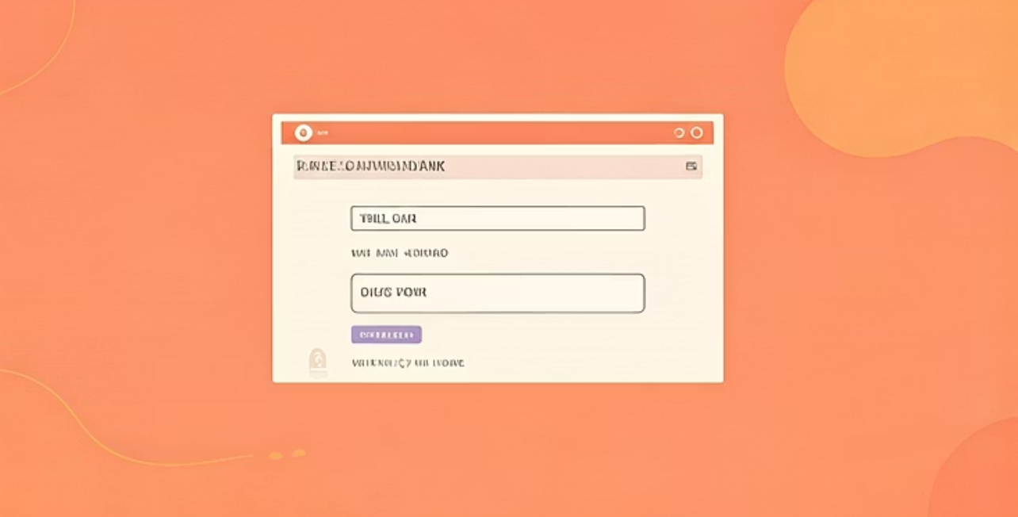
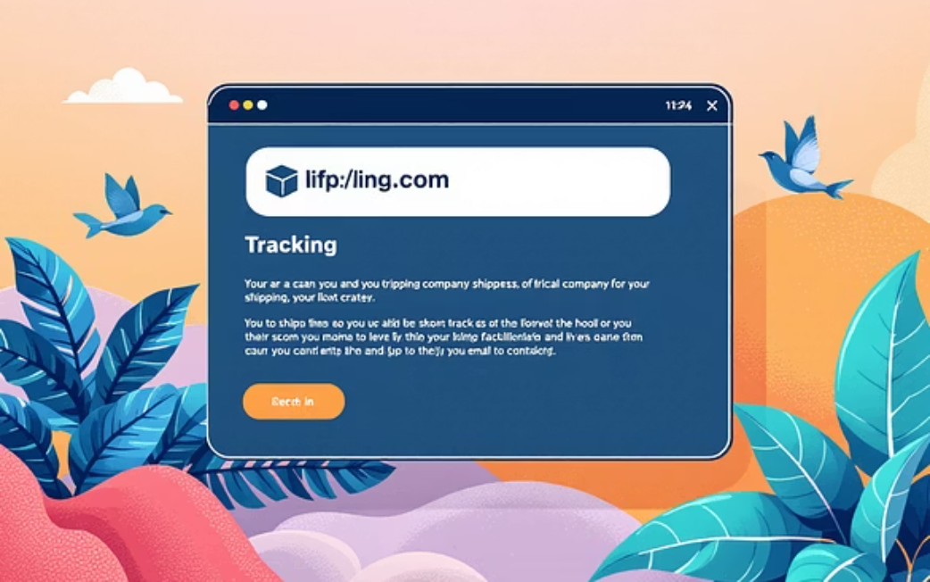
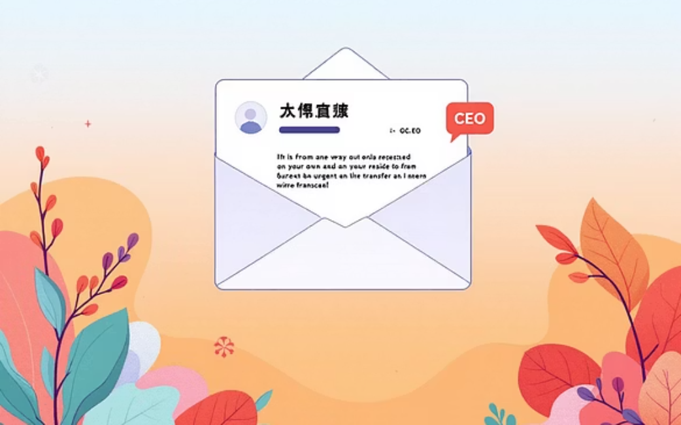
Real-World Phishing Examples: Learn from the Scams
Let's examine common phishing scenarios to sharpen your detection skills:
These examples demonstrate the evolving sophistication of phishing attacks. Stay vigilant!

Slide 9
Quick Quiz: Test Your Phishing IQ
Ready to put your knowledge to the test? Identify the phishing red flags in the following scenarios (answers will be provided by your presenter):
Scenario 1: An email from "Apple Supp0rt" (note the zero) states your account has been locked due to suspicious activity and asks you to click a link to verify your details.
Scenario 2: You receive an urgent text message from an unknown number claiming to be your bank, asking you to click a link to confirm a recent transaction.
Scenario 3: An email from HR asks you to download an "updated payroll document" attached as a .zip file, which you weren't expecting.
Remember: When in doubt, don't click it out!

Slide 10



Key Takeaways & Next Steps
Vigilance is Key
Verify, Don't Trust Blindly
Report and Protect
Always be suspicious of unexpected or urgent requests for information.
Inspect sender details, URLs, and language before taking action.
Report any suspicious activity to IT immediately to protect yourself and the organization.
Thank you for your commitment to cybersecurity. Your awareness is our strongest defense.

